Slide 1
PREDICTING STABLE BINARY COMPOUNDS FROM COMPOSITION
Malcolm Davidson
12 July 2019

Slide 2
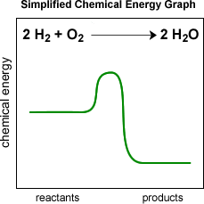
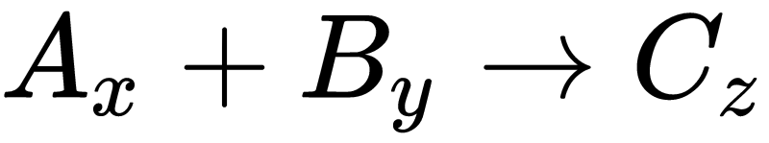

UNDERSTANDING THE CHALLENGE OF STABILITY PREDICTION
Because natural systems left to themselves move towards states of lower potential energy. Thermodynamics provides a deterministic approach for computing stability of a compound.
If we can determine the total energy (E_{Total} ) of the systems components, we can predict the stability of the product by looking for exothermic formation energies (E ^{C}_{Form} ). However measurement (spectroscopy and calorimetry) or computation (DFT) of the rotational, vibrational, chemical, and electronic energy of a chemical species can be timely and expensive. Which means an ML surrogate would be an excellent short-cut.
References: http://environ.andrew.cmu.edu/m3/s3/07stability.shtml, http://chemsite.lsrhs.net/chemKinetics/reactionsAndPotential.html, https://docs.quantumwise.com/tutorials/formation_energies/formation_energies.html

Slide 3
HOW DOES THE DATA DICTATE OUR APPROACH?
formula A | formula B | Stability Vector
Ne | He | [1.0,0.0,0.0,0.0,0.0,0.0,0.0,0.0,0.0,0.0,1.0]
formula
Ne
Ne_{0.1}He_{0.9}
Ne_{0.2}He_{0.8}
Ne_{0.3}He_{0.7}
Ne_{0.4}He_{0.6}
Ne_{0.5}He_{0.5}
Ne_{0.6}He_{0.4}
Ne_{0.7}He_{0.3}
Ne_{0.8}He_{0.2}
Ne_{0.9}He_{0.1}
He
A direct approach would be to perform multiple classification, where we provide all possible stability vectors as class labels
With the native form of the data, we have a complicated task of mapping onto an 11 dimensional space. A task suitable for a neural-network or one vs. all classification schemes.
formula | Binary Classifier
Ne | Yes
NeHe₉ | No
NeHe₄ | No
NeHe₂ | No
Ne₂He₃ | No
NeHe | No
Ne₃He₂ | No
Ne₂He | No
Ne₄He | No
Ne₉He | No
He | Yes
However, we can transfer the complexity of our output space to the input space allowing our model to better learn the trends governing stability. This also allows us to use simpler binary classifications models.
Coercing to the nearest integer formula gives access to more features like cohesive energy and ensures we predict compounds and not solid solutions or mixtures

Slide 4
SCREENING FOR WHICH MODEL SCHEME TO USE
Is there a modellable signal? Using a simple light weight classification algorithm like GNB is a quick method to see if pursuing further investigation is necessary. In this case with 77% classification accuracy it is! However, since so many materials tend to be unstable (class imbalance) the task is handled pretty well by just guessing unstable.
Predict the vector or predict the stability of compounds represented by the vector? We compare a LR model attempting to label formulas with one of 2¹¹ possible stability vectors or a LR model attempting to assign chemical formulas like A_{x}B_{y} a binary label of 1 or 0. We can see with a limited dataset of 2572 records the multiclass approach performs poorly compared to pursuing a binary classifications scheme.
*Preliminary testing conducted on 1000 record random sample to accelerate screening
Model Type | Accuracy | Error | Fit Time (s)
Gaussian Naive Bayes | 0.7769 | 0.0288 | 0.1
Logistic Regression (binary) | 0.8759 | 0.0442 | -
Control (binary) | 0.7858 | 0.0031 | -
Logistic Regression (multi-class) | 0.3863 | - | 77
Control (multi-class) | 0.4548 | 0.0044 | -
Gaussian Naive Bayes – (GNB) A simple and fast classification algorithm
Logistic Regression – (LR) A powerful classification algorithm capable of using multiple labels
Control – A naive classifier that simply labels with the most common output class

Slide 5
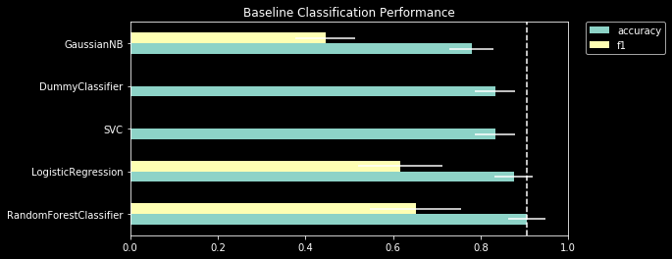
MODEL METRICS FOR CLASSIFICATION
formula | Binary Classifier
Ne | Yes
Ne₂He₃ | No
NeHe | No
TRAIN
formula | Binary Classifier
Ne₂He₃ | No
NeHe | No
Ne₃He₂ | No
TEST
Accuracy – The classification accuracy of the model
F1 score – A metric which combines the precision and recall of the model. Recall is a measure of the models true positive rate and precision is related to the false positive rate. A high F1 score means a balanced model.
Group Cross Validation - a method for determining model performance. 90 % of data used to train model evaluated on remaining 10 %. Test forbidden from containing formulas from chemical systems in the training set.
Figure 1. The baseline performance for several types of models that investigated for stability prediction.
*Preliminary testing conducted on a 1000 record random sample to accelerate screening

Slide 6
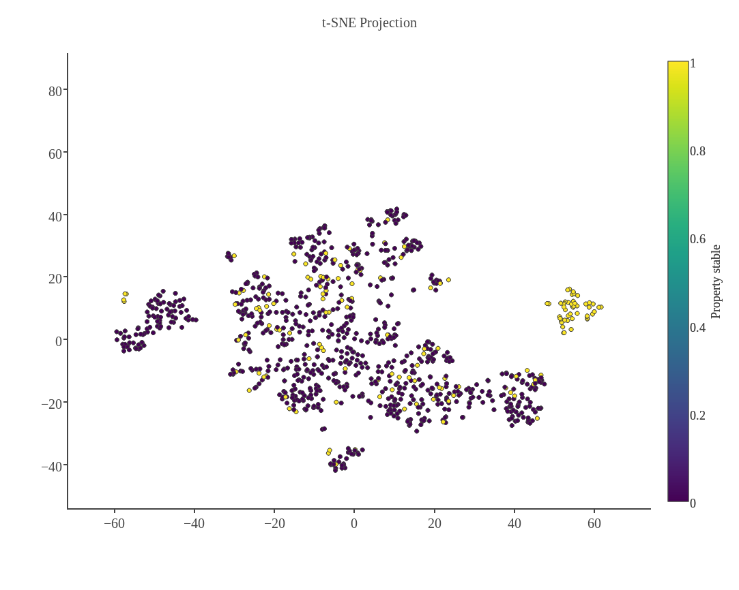
CAN DATA ANALYSIS GUIDE OUR MODEL CHOICE?
Clustering the data can help us choose a model
If the data is naturally clustered, a segmentation method like a support vector machine (SVC) may perform better than other classification models.
Figure 2 shows some clustering of the noble gasses and single elements, but the majority of the data is clumped. Which may explain why the Random Forest classifier (RFC) outperforms the SVC.
Addressing Class Imbalance
Clustering the data shows that the majority of the proposed compounds are unstable (20655) compared to 5147 stable compounds in the training data. Leaving this bias unaddressed can force the model artificially label inputs as unstable as we saw with the control.
Super sampling is a technique we can use to address this!
Compounds with noble gasses
Single Elements
Figure 2. T-stochastic neighbor embedding is a dimensionality technique the preserves both short and long range structure in data. We color based on stability (0 or 1).

Slide 7
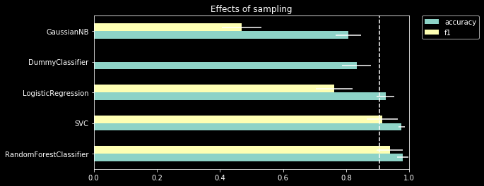
SUPER SAMPLING
Super sampling involves choosing the majority and minority output classes, unstable and stable respectively.
We then draw samples with replacement from the minority class training data until we have an equal number of records from each class.
Training Data
Super Sampled Data
Figure 3. The impact of super sampling on a variety of models applied to prediction of compound stability. In all cases except the control we see and improvement in both accuracy and f1 score.
*Preliminary testing conducted on a 1000 record random sample to accelerate screening. The dashed line is the accuracy of the best baseline model and is carried through each plot in this presentation.

Slide 8
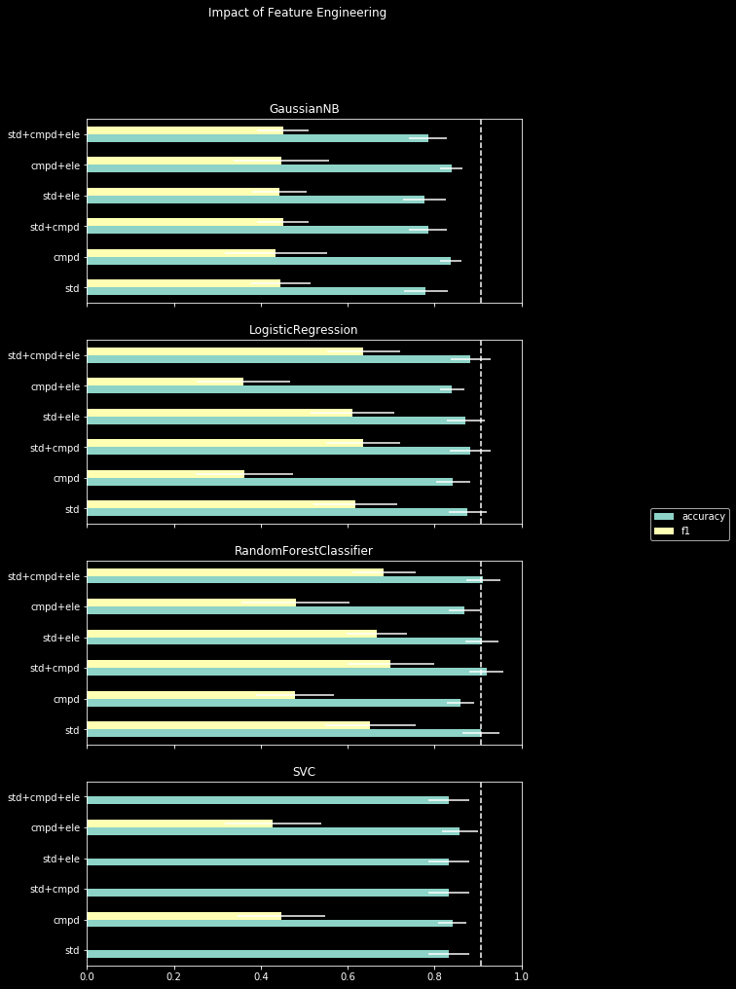
FEATURE ENGINEERING
Feature engineering governs the practice of how we represent our inputs to the model
Standard (STD) featurization typically involve calculation of stoichiometric norms and 134 properties computed from the compounds elements.*
Stability can be determined from the energy of formation for a compound, so we hypothesize that adding features relevant to formation energy should improve accuracy.
We provide the cohesive energy of a compound (cmpd_energy) and its constituent elements (ele). We see that a RFC with std+cmpd features maximizes accuracy.
However caution should be taken with these results as cohesive energies only exist for stable compounds.
*Ward, L., Dunn, A., Faghaninia, A., Zimmermann, N. E. R., Bajaj, S., Wang, Q., Montoya, J. H., Chen, J., Bystrom, K., Dylla, M., Chard, K., Asta, M., Persson, K., Snyder, G. J., Foster, I., Jain, A., Matminer: An open source toolkit for materials data mining. Comput. Mater. Sci. 152, 60-69 (2018).

Slide 9
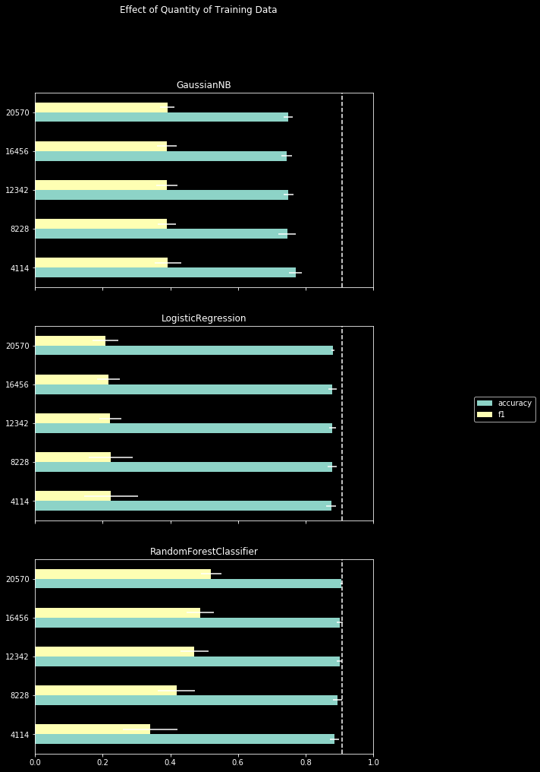
ADDING DATA
Many times in materials informatics we are constrained to small dataset sizes.
However more data does not always meaningfully improve a model.
Here we evaluated several potential models on increasingly larger datasets.
The RFC F1 improves significantly using more data, while accuracy is fairly constant. This is likely an effect of increasing class balance.

Slide 10
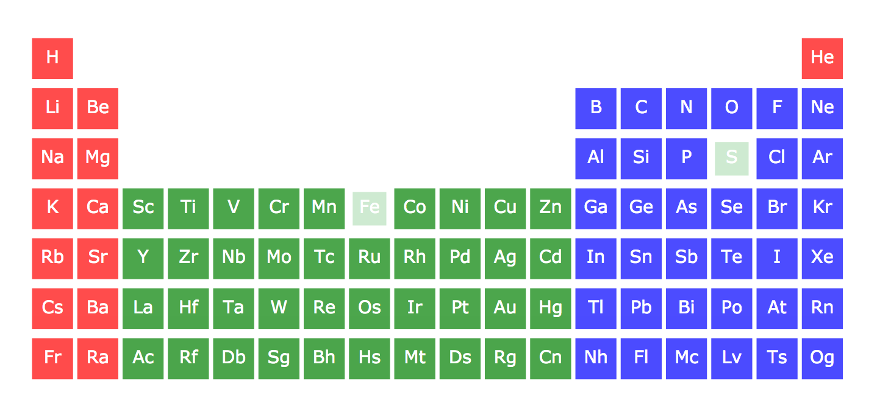
USING THE TOOL
We investigated the effects of data representation (binary vs. multi-class), segmentation models, sampling, featurization, and dataset size.
We found that a Random Forest Classifier the binary classification scheme on super sampled data featurize using stoichiometric norms, magpie elemental properties, and cohesive energies of the compound performed the best with a classification accuracy of ~90% and f1 score of ~60%.
We connected this model to a graphical interface to facilitate the prediction of binary compounds
Featurization
Predict
Stoichiometric Norms
Magpie Elemental Properties
Random Forest Classifier
Stable
Materials Project Cohesive Energy
*Ward, L., Dunn, A., Faghaninia, A., Zimmermann, N. E. R., Bajaj, S., Wang, Q., Montoya, J. H., Chen, J., Bystrom, K., Dylla, M., Chard, K., Asta, M., Persson, K., Snyder, G. J., Foster, I., Jain, A., Matminer: An open source toolkit for materials data mining. Comput. Mater. Sci. 152, 60-69 (2018).
MatMiner*

Slide 11
POSSIBLE IMPROVEMENTS
Consideration of temperature and pressure – compounds are stable at certain ranges of temperature and pressure.
Hyperparameter tuning – each type of model here has a set of parameters governing the architecture of the model. For a RFC some of these include the depth of trees or the number of leaves per node. A grid search can optimize these.
Grouping data by block or other chemically meaningful designation instead of by system during group k-folds could improve our assessment of accuracy.
Adding unit tests to improve reliability.

Slide 12
Thank You!

